Slide 1

Scenario- You Friend is having birthday, and he invited you for full day gathering along with 50 other people.

Slide 2

You accepted invitation and went on that day

Slide 3
After few minutes

Slide 4
You data is about to end
You have fully utilized your phone data, now phone data is 0%

Slide 5

Asking Wi-Fi details

Slide 6
Wi-Fi connection stage
Getting Wi-Fi details
Getting user id and password to make sure you are authorized person
Connected to network, Obtaining IP address
connected

Slide 7


Slide 8
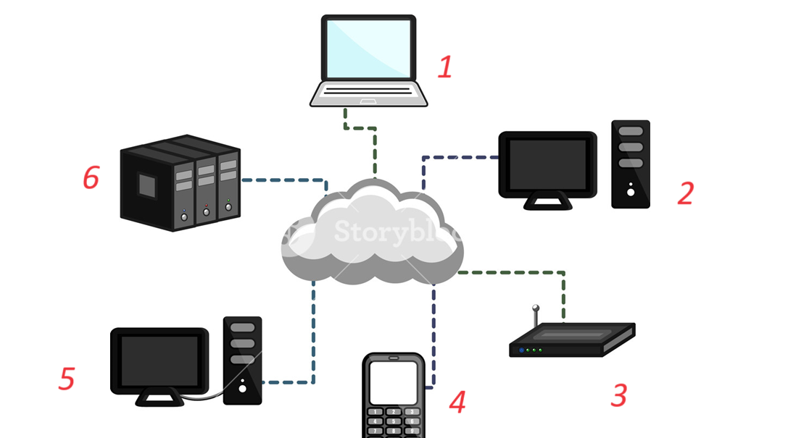
What is IP address
IP address is a number assigned to device

Slide 9
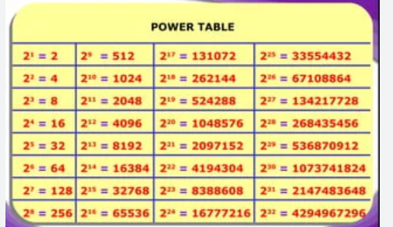
How many devices we can connected?
2 (power 32) -2 = 4294967294

Slide 10
Let’s break IP address into 4 part
The IP address is a 32 bit binary number. Dividing it into 4 parts of 8 bits each written as a decimal number (also called dotted decimal notation) makes it easier for the humans to read, interpret and use it.
Design a Network as per your Choice

Slide 11
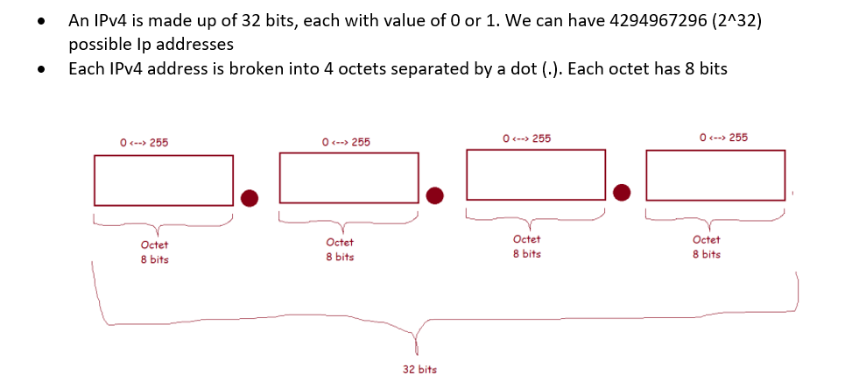

Slide 12
Why -2: Because below 2 Ip Can’t be used
1) The IP address number 0.0.0.0 is a nonroutable IPv4 address with several uses, primarily as a default or placeholder.
2) 255.255.255.255 – Represents the broadcast address, or place to route messages to be sent to every device within a network

Slide 13
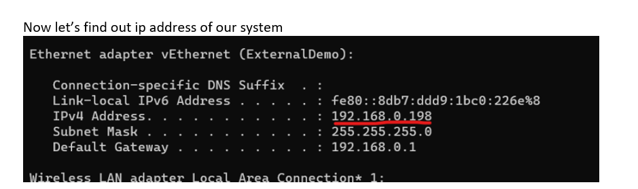

Slide 14
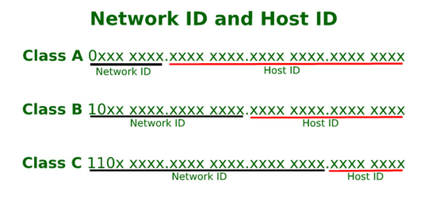
Each ip address has
• network id: unique id for the network
• host id: unique id for the host

Slide 15
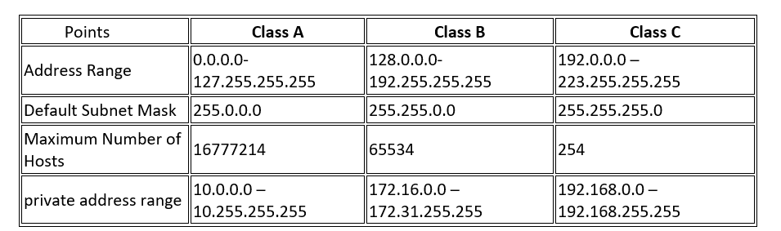

Slide 16
How to Design a network
With the help of Host ID and Network ID
Rule: Subnet mask is used to block those IP from use.

Slide 17
Private network and CIDR range
Private networks vs public networks:
Public network is accessible from the internet
Private network cannot be accessed from internet and is designed for internal communication.
Classless Inter-Domain Routing (CIDR):
Was introduced in 1993 to replace the classful addressing. It uses Variable length subnet masks
It has CIDR Notation which helps in representing subnet masks and ip ranges

Slide 18
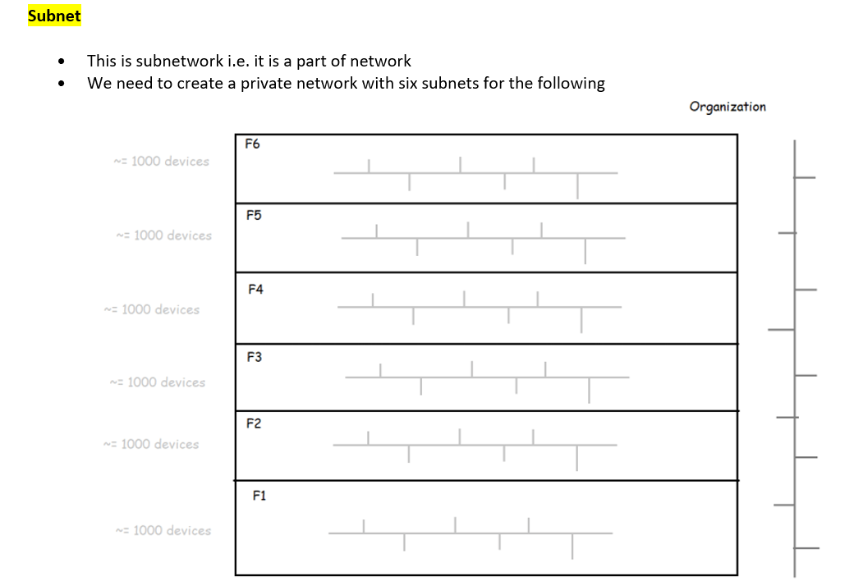

Slide 19
DNS server
A DNS server – short for Domain Name System server – converts web addresses into IP addresses.
Without a DNS server, you won't be able to connect to any websites.
If you're having issues with your default DNS server, you can change it.

Slide 20
Component of DNS server
The DNS recursive resolver(It saves local copy of DNS record)
The root nameservers- It can’t help, but it cam tell you who can help(TLD- top level domain server)
The TLD nameservers
The authoritative nameservers(It has all information about network)

Slide 21
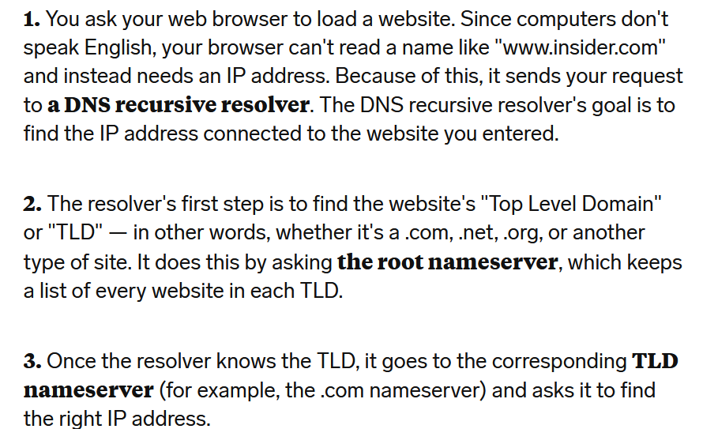

Slide 22
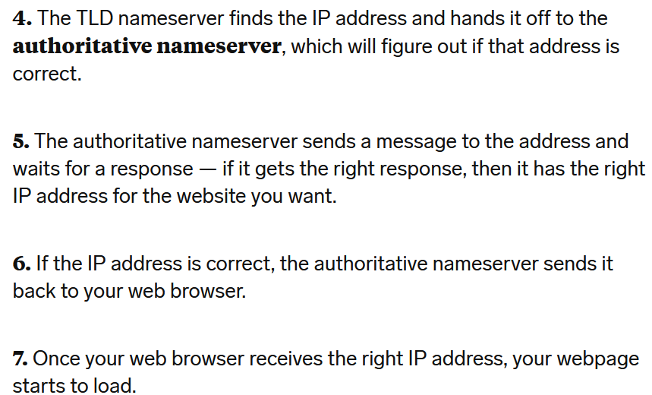

Slide 23
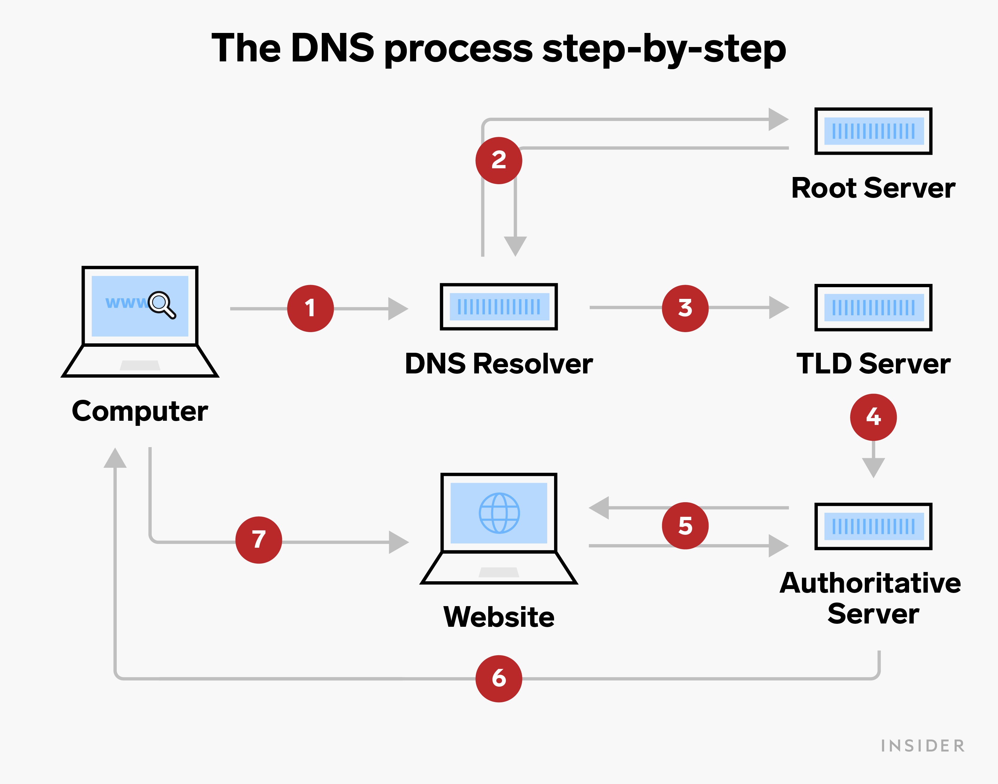
How DNS server works

Slide 24
DHCP
Dynamic Host Configuration Protocol (DHCP) is used to dynamically assign Internet Protocol (IP) addresses to each host on your organization's network.

Slide 25
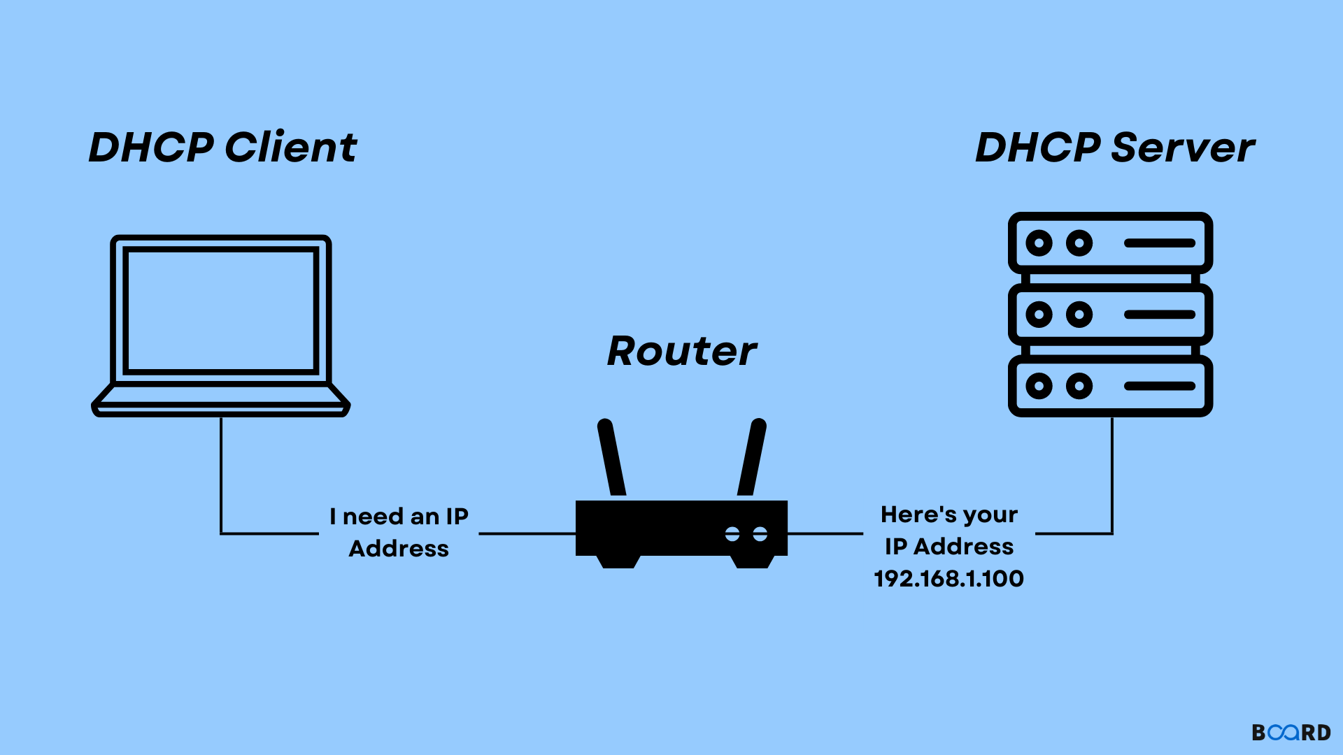

Slide 26
CPU
The CPU interprets, processes and executes instructions, most often from the hardware and software programs running on the device. The CPU performs arithmetic, logic, and other operations to transform data input into more usable information output.
It perform Input, Output, Arithmetic and logical operation

Slide 27
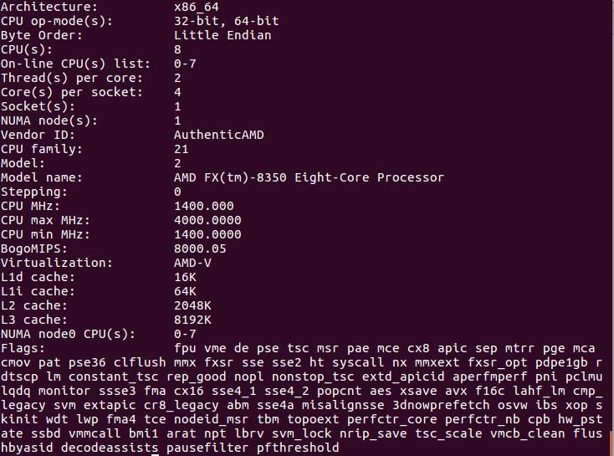
How to check CPU details for server

Slide 28
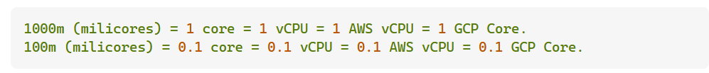
What happen when my application need more CPU?
Assign more then 1 CPU.
Note: A single core can be executing one instruction for one thread at a time.

Slide 29
ROM
ROM is a non-volatile form of memory that stores data permanently and cannot be written over or erased
Why we need ROM?
System uses ROM to store fixed information
Example: TV remote memory or washing machine memory

Slide 30
ROM Usage
It’s very powerful in terms of calculation, and it will not forget when power goes down. It always start from where if left.
Example: Washing machine Timer

Slide 31
RAM
RAM is a temporary memory bank where your computer stores data it needs to retrieve quickly. RAM keeps data easily accessible so your processor can quickly find it without having to go into long-term storage to complete immediate processing tasks
More the RAM means more the system speed.

Slide 32
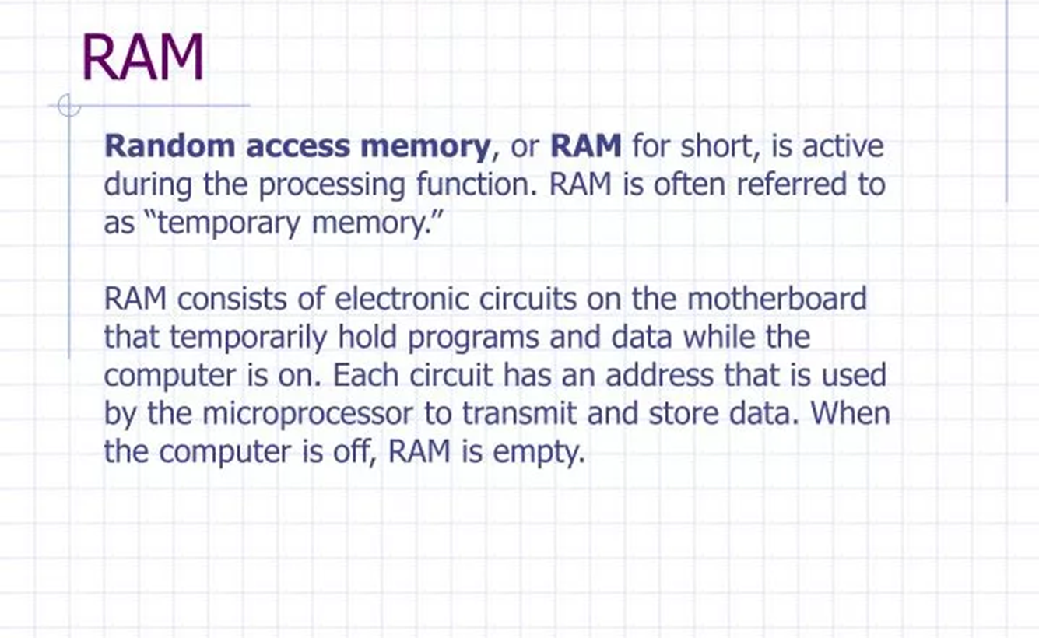

Slide 33
Storage
The storage unit is a part of the computer system which is employed to store the information and instructions to be processed. A storage device is an integral part of the computer hardware which stores information/data to process the result of any computational work. Without a storage device, a computer would not be able to run or even boot up. Or in other words, we can say that a storage device is hardware that is used for storing, porting, or extracting data files. It can also store information/data both temporarily and permanently.

Slide 34
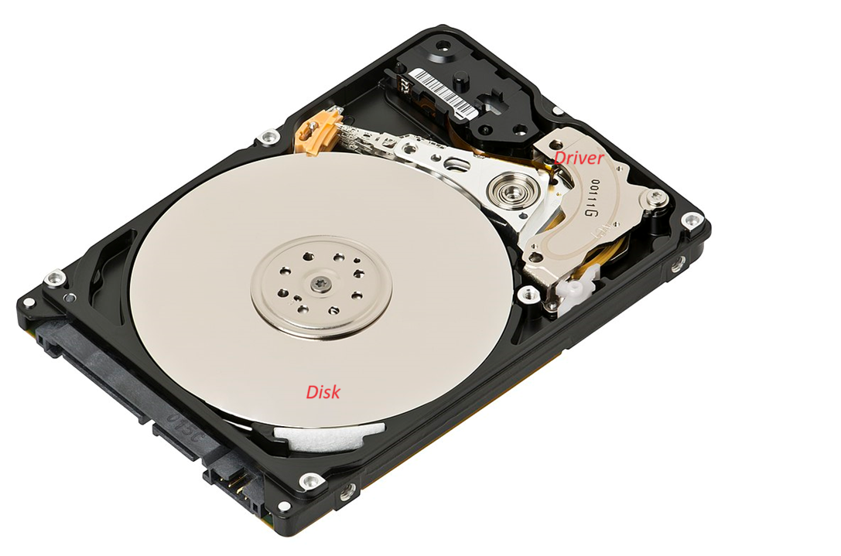
HDD: Hard Disk Drive

Slide 35
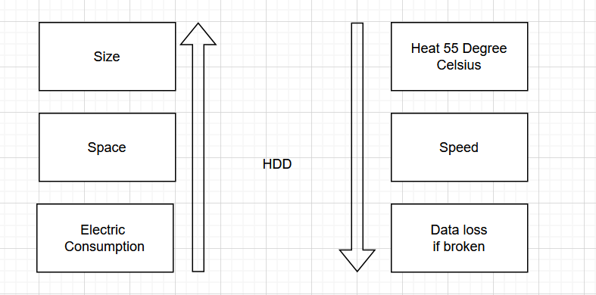
HDD properties

Slide 36
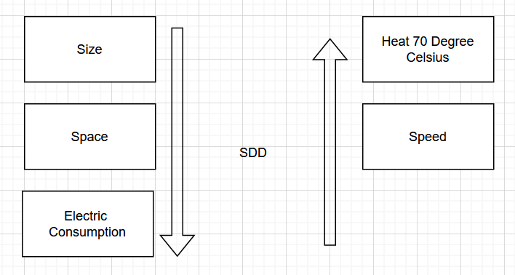
SDD

Slide 37
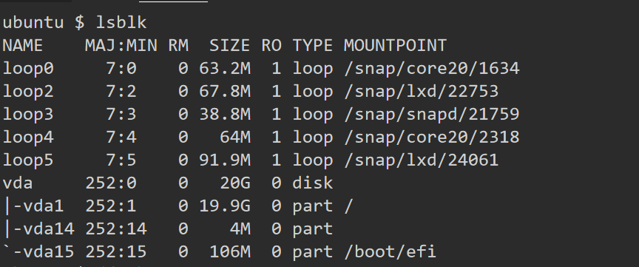
lsblk: listing the hard disk used

Slide 38
Data Type
Structured Data
Highly organized and easily searchable in databases
Examples: Tables, columns, rows.
Unstructured Data
Not organized in a predefined manner.
Examples: Text documents, images, videos, social media posts.
Semi-Structured Data
Contains elements of both structured and unstructured data.
Examples: XML, JSON, HTML.

Slide 39
Storage Type in Azure
Blob: Unstructured data
File: Data sharing between 2 files[Connect option]
Table : Structured data
Queue: Messaging Queue
Azure Storage Account:
An Azure storage account contains all of your Azure Storage data objects: blobs, files, queues, and tables. The storage account provides a unique namespace for your Azure Storage data that's accessible from anywhere in the world over HTTP or HTTPS. Data in your storage account is durable and highly available, secure, and massively scalable.

Slide 40
Resource Group in Azure
A resource group is a container that holds related resources for an Azure solution. The resource group can include all the resources for the solution, or only those resources that you want to manage as a group.
Note: It’s Mandatory to have Azure resource group without that you can’t proceed.
In Simple term, it’s a folder which keep information in one place

Slide 41
VNET
First rule of networking is devices within network can access each other.
If this is the case then if I am creating my servers in a Zone, Somone else can access it.
To solve this problem Azure provides ARM concept which provides a separate network within Datacenter.

Slide 42
Demo for activities
Creating virtual machine into Azure and login into it.
Creating storage account, and different type of storage.

Slide 43
Homework
Terraform code to create VM
Terraform code to create all types of storage in Azure
Explore ARM, VNET, STORAGE and VM into azure by Microsoft link.

